Slide 1
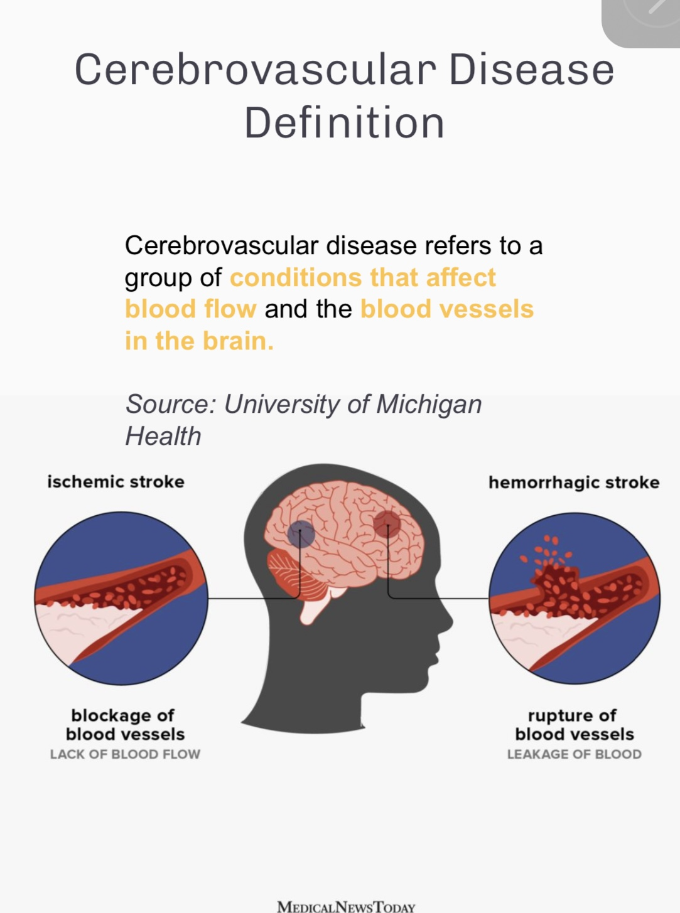

Slide 2
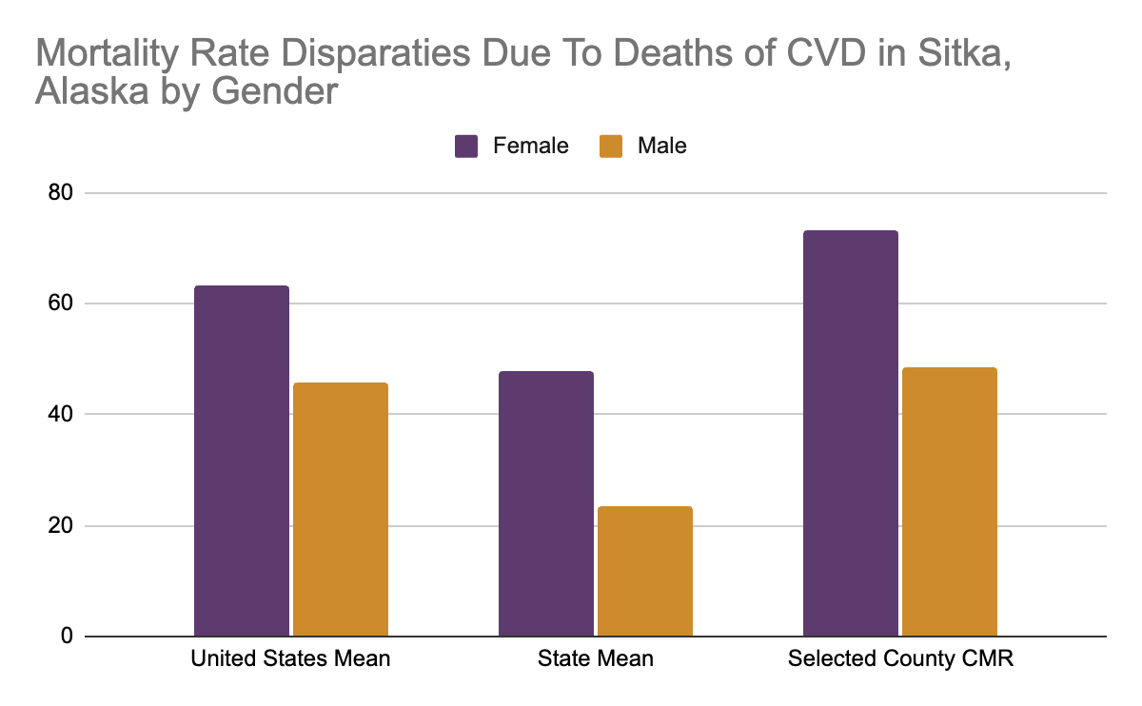
Sitka has the highest incidence of Female and Male deaths occur in the same county
These county is the same county I chose for Sprint #1?
Females seem to carry the largest mortality burden
The crude rate for females was x1.8 higher than males

Slide 3
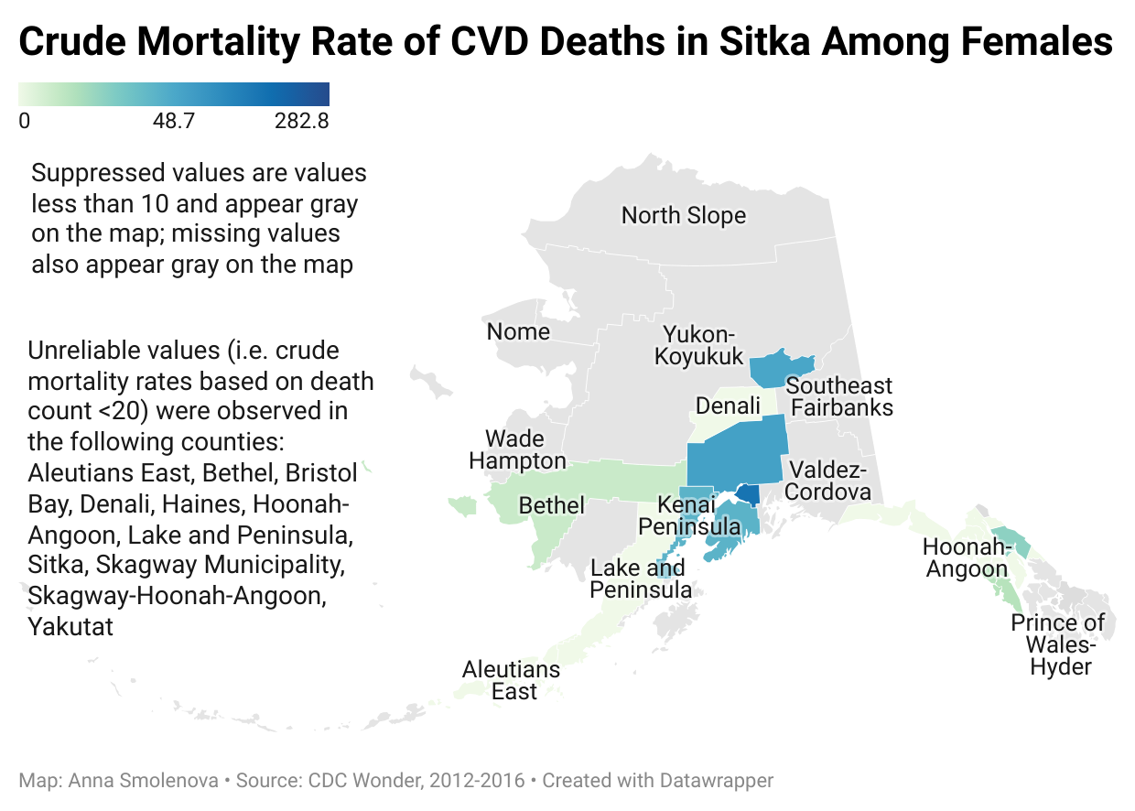
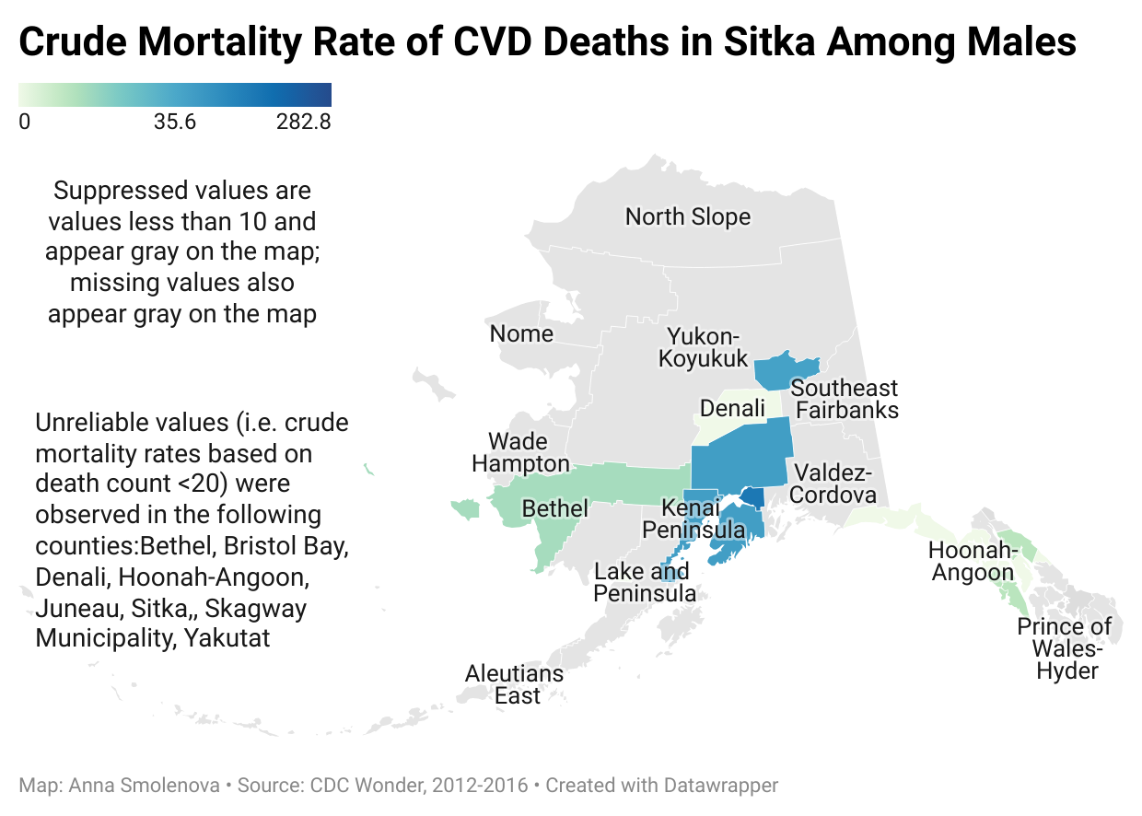

Slide 4
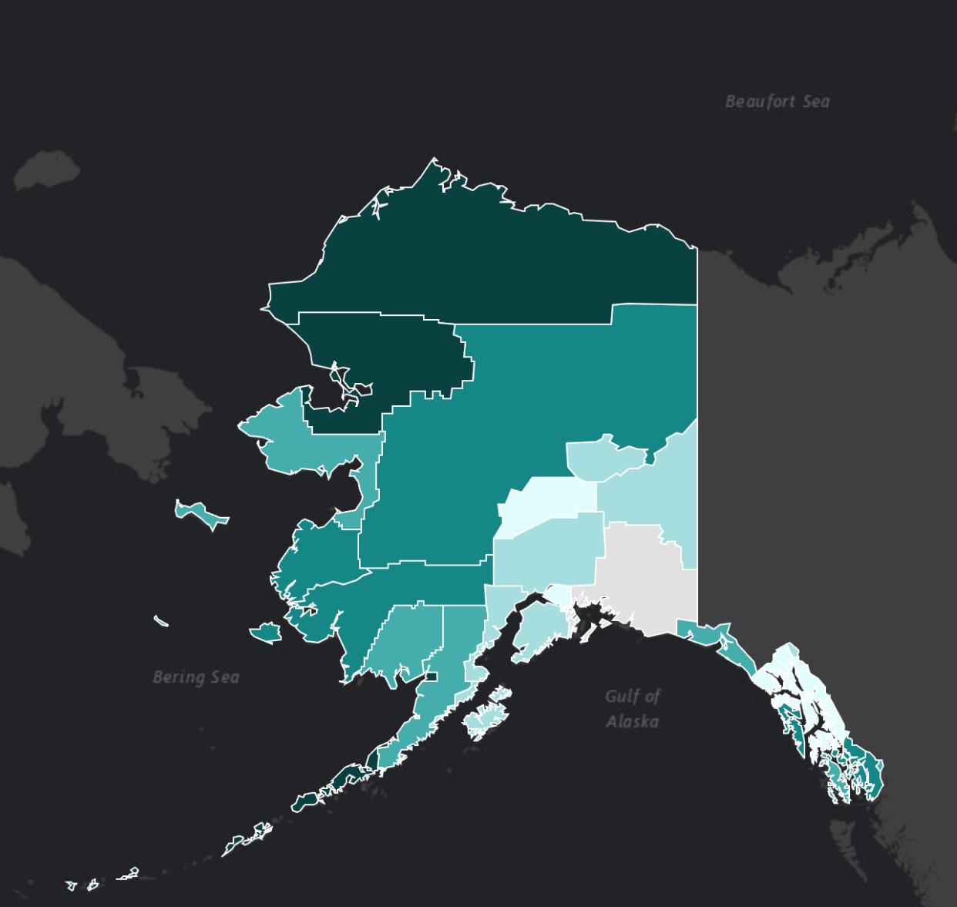
CVD Risk Factors
The most important behavioural risk factors of heart disease and stroke are unhealthy diet, physical inactivity, tobacco use and harmful use of alcohol. Amongst environmental risk factors, air pollution
The effects of behavioural risk factors may show up in individuals as raised blood pressure, raised blood glucose, raised blood lipids, and overweight and obesity
Source: WHO
Diagnosed Diabetes
Source: CDC

Slide 5
Demographics
Sitka is considered a rural area.
Average age - 39.5 years
White: 62.27%
Two or more races: 17.51%
Native American: 9.37%
Asian: 7.88%
Native Hawaiian or Pacific Islander:
1.22% Other race: 1.06%
Black or African American: 0.69%
Source: United States Census Bureau,
Worldpopulationreview

Slide 6
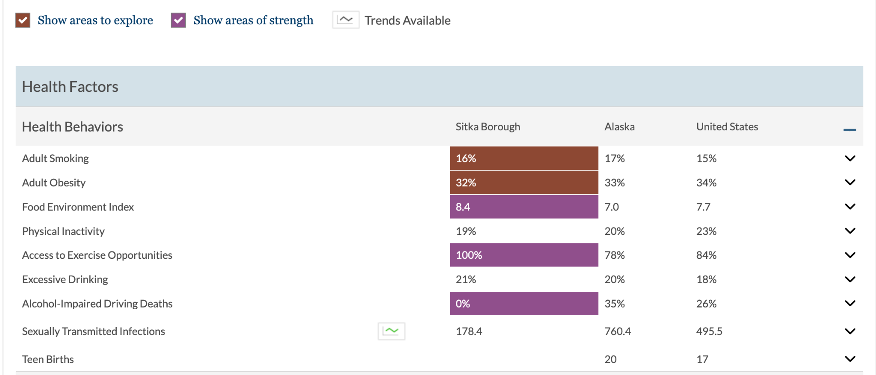
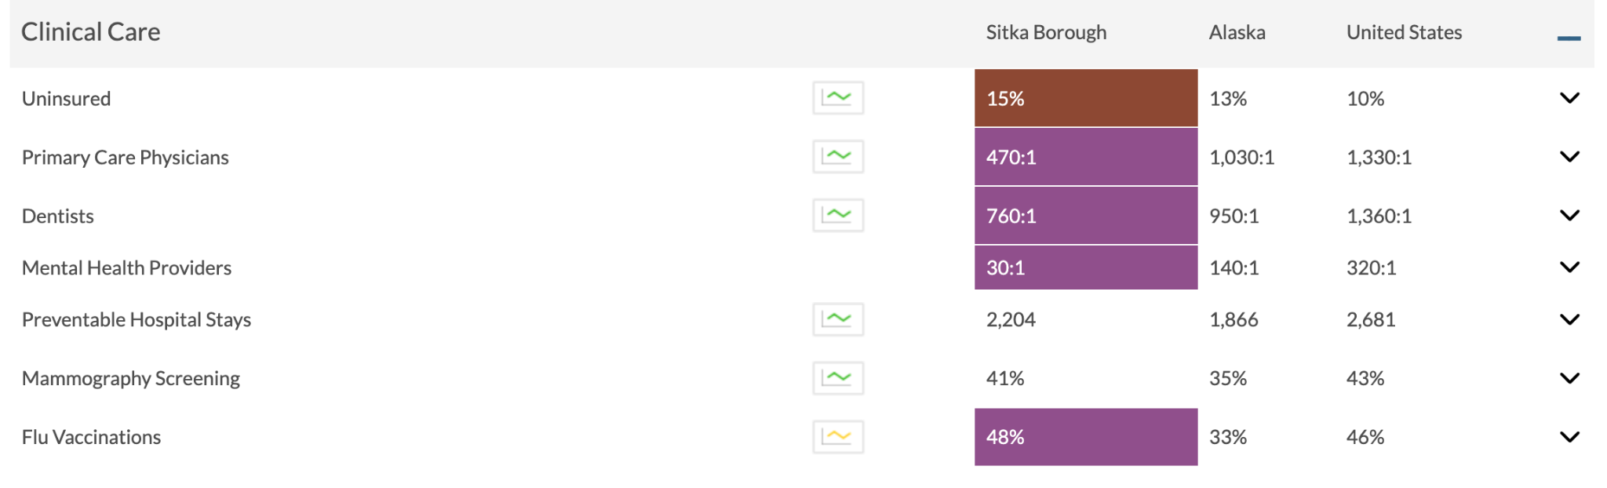
Health Factors &
Clinical Care
Source: countyhealthrankings

Slide 7
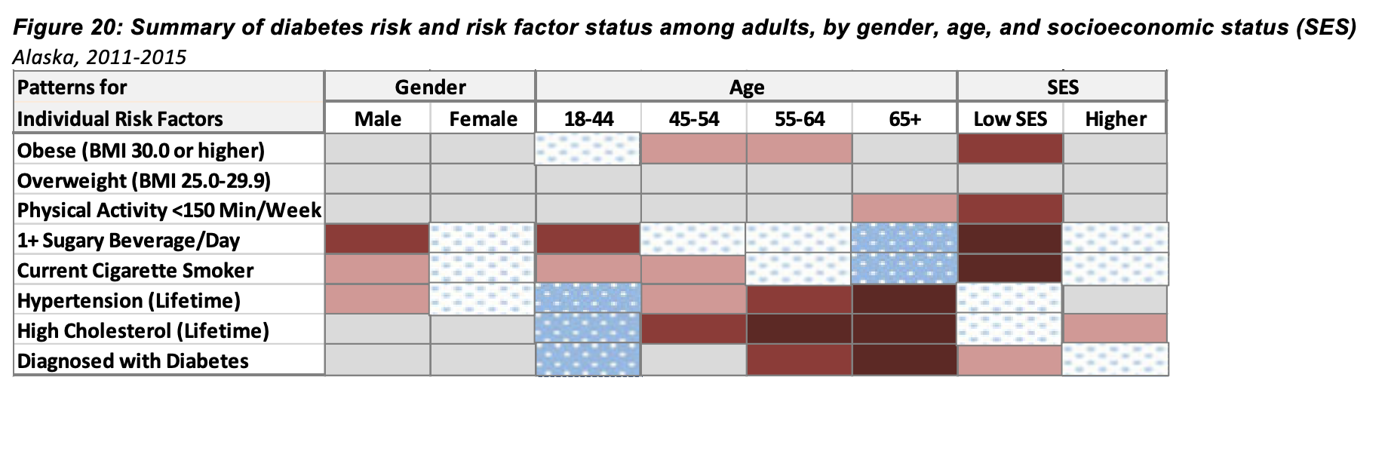
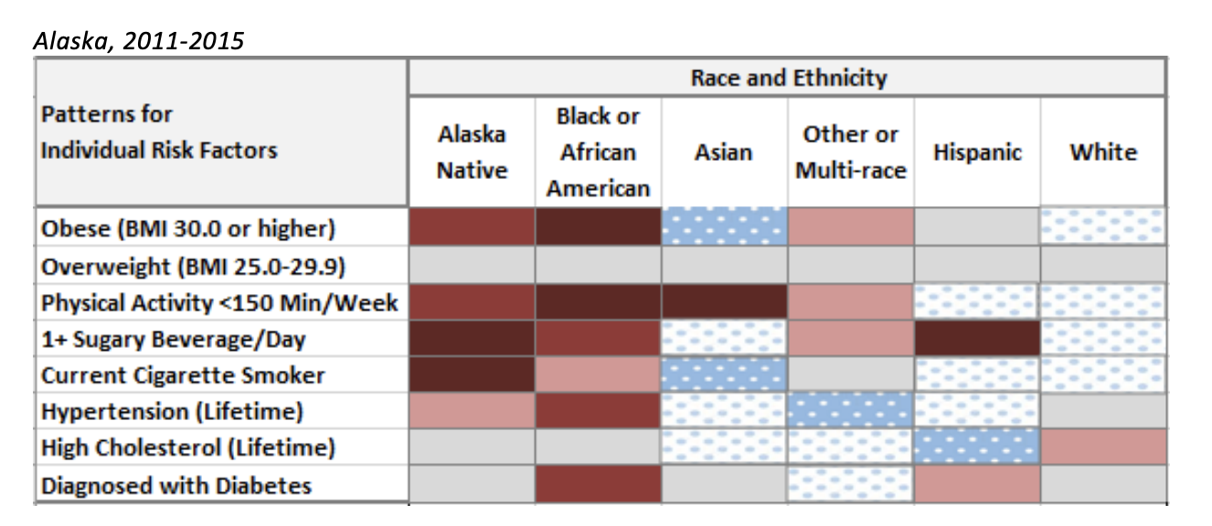
Risk Factors by Gender,
Age, Race

Slide 8
Legislation
The Alaska House passed a bill Monday that would legalize subscription-based health care in Alaska. (April 8, 2024)
Saving Alaska Medicare Beneficiaries Money by Capping Insulin Copays at $35 per Month. (The Inflation Reduction Act)
Early insulin therapy may have cardiovascular may benefits for patients with newly diagnosed T2D by reducing the risk of incident stroke and hospitalization for HF, supporting early insulin therapy as an initial option for newly diagnosed T2D.
Source: Nature

Slide 9
Recommendations
Ensuring secondary prevention
Reducing hospitalization by increasing screening of people with high pressure, who may not be aware of their state & family screenings
Promoting healthy lifestyle & increase awareness about disease prevention (e.g. the Million Hearts ABCS)
Changing environments (e.g. reducing sugar intake & sodium intake, increasing fruit & vegetables intake, reducing excessive drinking & caffeine)
Increasing the quality of emergency services
DNA testing
Mental illness testing
Sources: HealthyPeople2030 & The Burden of Heart Disease and Stroke in Alaska

Slide 10
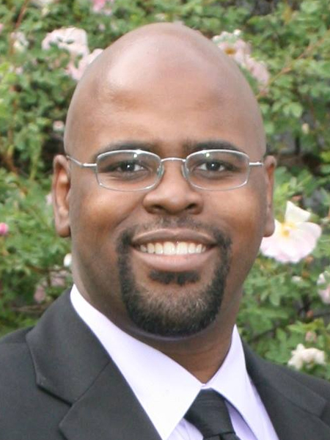
Senator David Wilson
Email: Senator.David.Wilson@akleg.gov
Party: Republican
Toll-Free: 800-862-3878
Prime Bill sponsorship
OPIOID OVERDOSE DRUGS
DENTISTS/DENTAL HYGIENIST/RADIOLOGY EQUIPMENT
HEALTH CARE SERVICES BY TELEHEALTH
INTERFERENCE WITH EMERGENCY SERVICES
PRESCRIPTION DRUGS; COST SHARING

